Slide 1
Review and Discussion Session 12
Course : COMP6575 – Research Topics in Computer Science
Effective Period : December 2019

Slide 2
Learning Outcomes
At the end of this session, students will be able to:
LO 3: Analyze the results from the research study
LO 4: Write a research paper with the appropriate format

Slide 3
Outline
Review
Discussion

Slide 4
Review

Slide 5
Research Topics in Computer Science
Currently there are huge numbers of promising topics that vary in difficulties.
The starting point of your research should be starts from your interest (might be depends on you streaming)

Slide 6
Guideline to select your topic
What is the problem you are trying to solve?
How do you solve it?
What are the benefits?
How is the scope?

Slide 7
Literature Review
Literature review helps to determine whether the topic is worth studying
it provides insight into ways in which the researcher can limit the scope to a needed area of inquiry
It shares with the reader the results of other studies that are closely related to the one being undertaken
Literature sections in proposal are generally shaped from the larger problem to the narrower issue that leads directly into the methods of a study

Slide 8
Steps in Conducting a Literature Review
A literature review means locating and summarizing the studies about a topic.
There is no single way to conduct a literature review, but many scholars proceed in a systematic fashion to capture, evaluate, and summarize the literature:
Begin by identifying key words, which is useful in locating material in an academic library at college or university.
With these key words in mind, go next to library and begin searching the catalog for holdings.
Initially try to locate about 50 reports of research in articles or books related to research on your topic.
Skip the initial group of articles or chapters, and duplicate those that are central to your topic.
As you identify useful literature, begin designing a literature map.
Draft summaries of the most relevant
After summarizing the literature, assemble and structuring it thematically or organizing it by important concepts

Slide 9
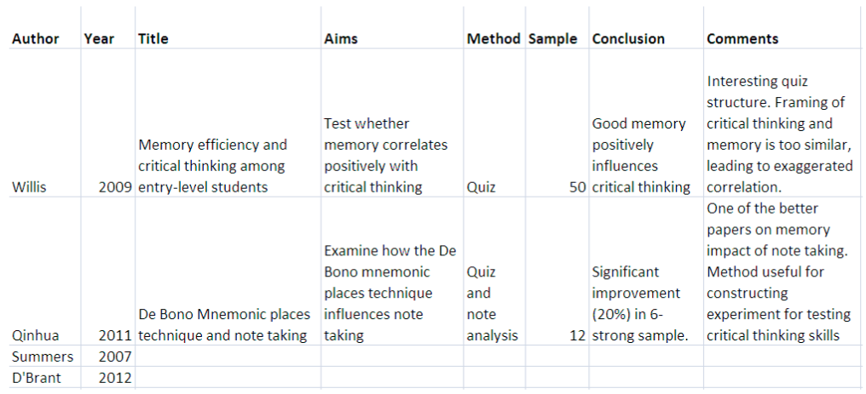
Table of comparison
Another way of managing sources and arguments presented in them is to use a literature review matrix (also called synthesis matrix). Literature review matrix is a table in which you can represent the views, ideas, or data according to thematic categories that correspond to your research project.

Slide 10
The 5 Goals of Citations
Provide sufficient context of the work to allow for critical analysis of the work by others and thus to enable the readers to gauge themselves whether the author’s conclusions are justified
Give the reader sources of background and related material so that the current work can be understood by the target audience (thus creating a web of science)
Establish credibility with the reader (e.g., the authors knows the field, have done their homework, etc.) and/or inform the reader that the paper belongs within a specific school of thought;
Provide examples of alternate ideas, data, or conclusions to compare and contrast with this work
Acknowledge and give credit to sources relied upon for this work (i.e., acknowledge the use of another’s ideas or data), thus upholding intellectual honesty.

Slide 11
The Deductive Approach Typically Used in Quantitative Research
Researcher test or verifies a theory
Researcher test hypotheses or research questions from the theory
Researcher defines and operationalized variables derived from the theory
Researcher measures or observes variables using an instrument to obtain scores

Slide 12
The Inductive Logic of Research in a Qualitative Study
Researcher gathers information (e.g., interviews, observations)
Researcher asks open-ended questions or participants or record fieldnotes
Researcher analyzes data to form themes or categories
Researcher looks for broad pattern, generalizations, or theories from themes or categories
Researcher poses generalizations or theories from past experiences and literature

Slide 13
Structure and Organization
Writing is inherently a creative process
Many scientists do not think of themselves as qualified readers, finding the task of writing both intimidating and arduous
There is a formula for how to structure and organize a scientific paper, so that the scientist/writer can focus on what they know best– the science – and worry less about the writing

Slide 14
The Standard Structure of a Scientific Paper
The vast majority of papers published in scientific journals today follow a fairly simple structure. With some variations, most papers use an “IMRaD” format:
Introduction
Method (experiment, theory, design, model)
Results and Discussion
Conclusions

Slide 15
Structured Abstracts
In engineering and physical sciences a five-structure format is probably best :
Background
What issues led to this work? What is the environment that makes this work interesting or important?
Aim
What did you plan to achieve in this work? What gap is being filled?
Approach
How did you set about achieving your aims (e.g. experimental method, simulation approach, theoretical approach, combination of these, etc.), what did your actually do?
Results
What were the main results of the study (including numbers, if appropriate)?
Conclusions
What were your main conclusions? Why are the results important? Where will they lead?
Each subsection should contain 1 to 2 sentences

Slide 16
Titles
Once the abstract is finished, it is time to write the title
Unfortunately, it is against human nature to write the title last. Instead, the title is often the first thing written, at the top of that blank document that will soon become your manuscript.
It is probably impossible to define a universal procedure for creating a good title – there is no equivalent “structure method” for writing a title.
There are some basic guidelines, however that make use of the structured abstract to guide the creation of the title.
In general, the title should reflect the aim and approach of the work

Slide 17
The Scientific Style
According to Thomas and Turner, a writing style is defined by the stand taken on 5 issues:
Truth
Presentation
Scene
Cast
Thought and Language

Slide 18
The Goals of Using Figures
As a form of communication, figures (and in particular, the graphical display of quantitative data) are uniquely suited to conveying information from complex data sets quickly and effectively.
Graphs take advantage of the magnificent power of the human brain to recognize visual/spatial pattern and to quickly change focus from the big picture to small details.
Graphs are extremely popular in scientific literature for the simple reason that they work so well.
But like all the forms of communication, graphics can be used to explain and clarify but also to confuse or deceive.

Slide 19
Tables
Tables present data directly and are preferred over graphs when the exact numerical values of the data are needed
Still, tables often have a goal similar to that for figures: enabling comparison
As with figures, tables should be made comprehensible on their own, without reference to the text of the paper, if possible
Table should have a good caption, and the items presented should be clearly defined within the table
Do not forget units and uncertainty estimates

Slide 20
Introduction to Right Journal (1)
A simmering question facing the scientist or engineer thinking about publishing a peer-reviewed paper is which journal to submit to.
What factors should lead to a decision as to the most appropriate publication venue for your work?
Relevance
Acceptance rate
Circulation
Prestige
Publication time

Slide 21
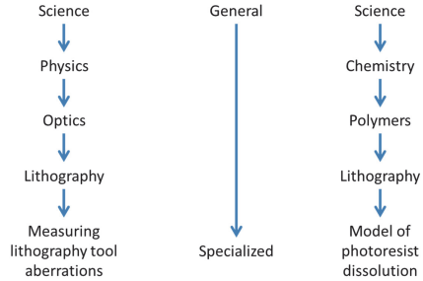
Introduction to Right Journal (2)
The preceding questions address the specialization spectrum of science journals
At the top (Most general) are the interdisciplinary science magazines, with famous journals like science and nature attempting to publish significant and timely research of wide interest
At the bottom are the most specialized where further specialization is not practical due to the diminishing number of practitioners

Slide 22
Introduction to Right Journal (3)
There is no right answer to these questions because they depend specifically on the paper and the goals of the author
However, one thing is clear : moving up or down the specialization spectrum is not inherently better or worse.
There is no doubt that the best general-science journals have higher levels of prestige, often associated with a higher journal impact factor
Send your manuscript to the one with the highest impact factor that you think may accept it

Slide 23
Discussion

Slide 24
References
John W. Creswell. (2017). Qualitative, Quantitative, and Mixed Methods Approaches Research Design:5th edition. SAGE Publications, Inc. ISBN: 978-1-5063-8671-3
Chris A. Mack. (2018). How to Write a Good Scientific Paper. Society of Photo-Optical Instrumentation Engineers (SPIE). ISBN: 978-1-5106-1913-5

Slide 25
Thank you

